Slide 1
CityGML 3.0 GML Encoding
CityGML chairs and editors
OAB XX August 2022

Slide 2
CityGML 3.0 GML Encoding Standard
[Pretty picture]

Slide 3
Agenda
Scope
Overview
Structure of Standard
Implementations
What has changed between CityGML 2 and CityGML 3 GML
Q&A

Slide 4
CityGML Editorial Team [Tatjana]
CityGML 3.0 GML Encoding Editors
Dr. Tatjana Kutzner, Chair of Geoinformatics, Technische Universität München
Dr. Claus Nagel, CTO, virtualcitySYSTEMS GmbH, Berlin
Diego Vinasco-Alvarez, Université Lumière Lyon 2
Prof. Dr. Thomas H. Kolbe, Chair of Geoinformatics, Technische Universität München
Prof. Dr. Volker Coors, HfT Stuttgart?
Dr.-Ing. Zhihang Yao, Technische Universität Münch
Nobuhiro Ishimaru, XXXXXX, YYYYYYY
Charles Heazel, XXXXXX, YYYYYYY
Carl Smyth, Architect, OpenSitePlan

Slide 5
CityGML Scope
CityGML targets representations of objects in semantic categories relevant to human activities on or near the earth’s surface.
Focuses on features as the exist and can be sensed by people and devices.
Enables semantically structured modelling of both the natural environment and man-built features.
The conceptual model informs the development of both exchange formats and run-time representations.
Application scope:
Visualization
Search: show / highlight objects that match queries on objects, attributes and relationships; choose rendering or 3D cartographic styles according to semantic information
Analysis: how do features relate; stability; wave/energy propagation or dispersal
Navigation: how to move through an environment
Simulation: exploring dynamic response of an environment
Data Integration: CityGML features link data from different application domains

Slide 6
Overview: CityGML
The CityGML 3.0 conceptual model was derived from CityGML 2.0 (document 12-019) and is expressed as a UML static class diagram.
Separating conceptual model from physical implementations enabled a Model Driven Architecture:
Note: We kept the CityGML name even though it obscures the separation of the conceptual model, because of wide recognition of the name – please don’t be confused. That is the reason that this encoding is the CityGML 3.0 GML Encoding, which appears redundant at first glance.
We expect multiple implementation (encoding) specifications to be developed based on the 3.0 conceptual model
GML first – already have automated XSD conversion and 2.0 => 3.0 tools
3DCityDB, JSON (CityJSON target)

Slide 7
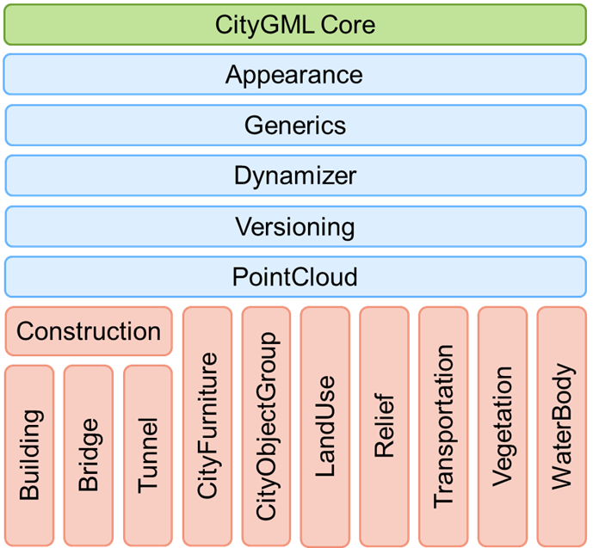
Overview: CityGML 3.0 Modules
Revised
Defines base concepts and geometries inherited by all other modules
Revised
New
Defines concepts applicable to all thematic modules
New
New
New
Thematic modules
Revised
Revised

Slide 8
[Tatjana slide for transition between conceptual and encoding]

Slide 9
Structure of Standard [Steve]
Normative part:
Specification document with conformance classes directly referencing XML schemas
XSD files generated directly from conceptual model via ShapeChange
Additional GML-specific requirements
Informative part:
Recommendations
Test datasets
Example XML and CSV codelists on OGC server
Examples of definition and encoding of ADEs
[Developer friendly]

Slide 10
CityGML 3.0 GML Implementations [Tatjana]
GML Encoding and Implementations
The CityGML 3.0 GML schemas are derived with standard tools (ShapeChange) which are also used for INSPIRE and other national data models and formats.
The CityGML 3.0 GML schemas are based on GML 3.2 which means that
they are compliant to ISO standards,
all software tools that can read and process generic GML 3 application schemas can also work directly with CityGML 3.0 data sets (e.g. FME, HALE, GDAL, Interactive Instruments WFS, Deegree, GALDOS WFS, CPA SupportGIS, FZKViewer, Snowflake Go-Publisher).

Slide 11
CityGML 3.0 GML Implementations [Claus]
OGC CityGML 3.0 Hackathon, OGC CityGML 3.0 Challenge
First open-source prototype implementations and tools
Programming tools
Converters
Validators
citygml4j,
generic support in all tools/libraries supporting GML 3.2
IFC -> CityGML 3.0 via FME Workspace https://github.com/tum-gis/ifc-to-citygml3
GDAL,
Follow-on CityDotNet supports CityGML 3.0 GML input
[check emails for more]

Slide 12
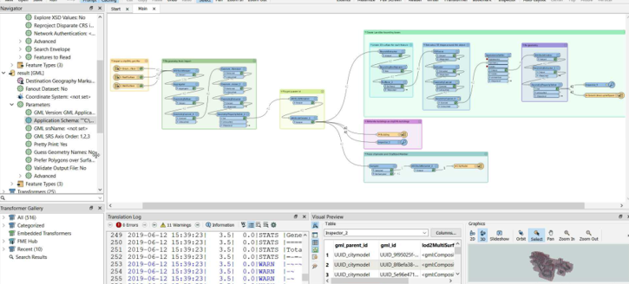
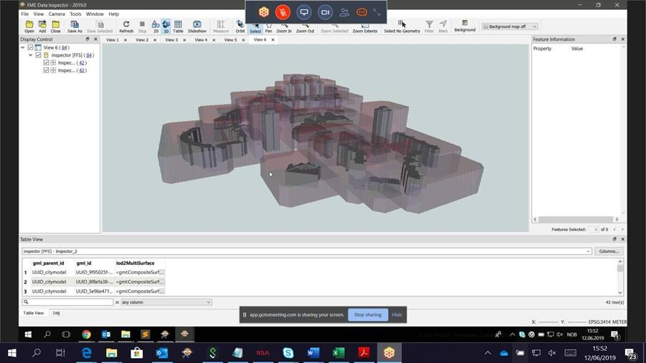
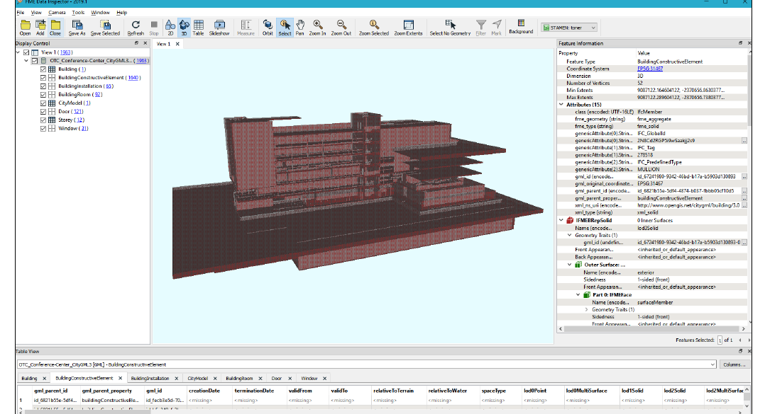
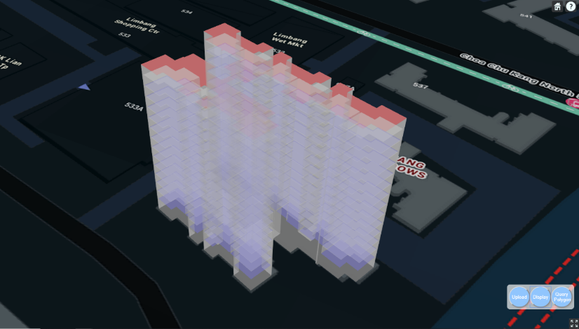
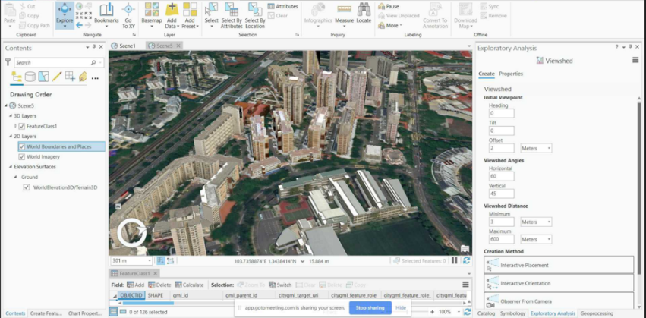
Examples: OGC CityGML 3.0 Hackathon
June 2019 at Geovation, London

Slide 13
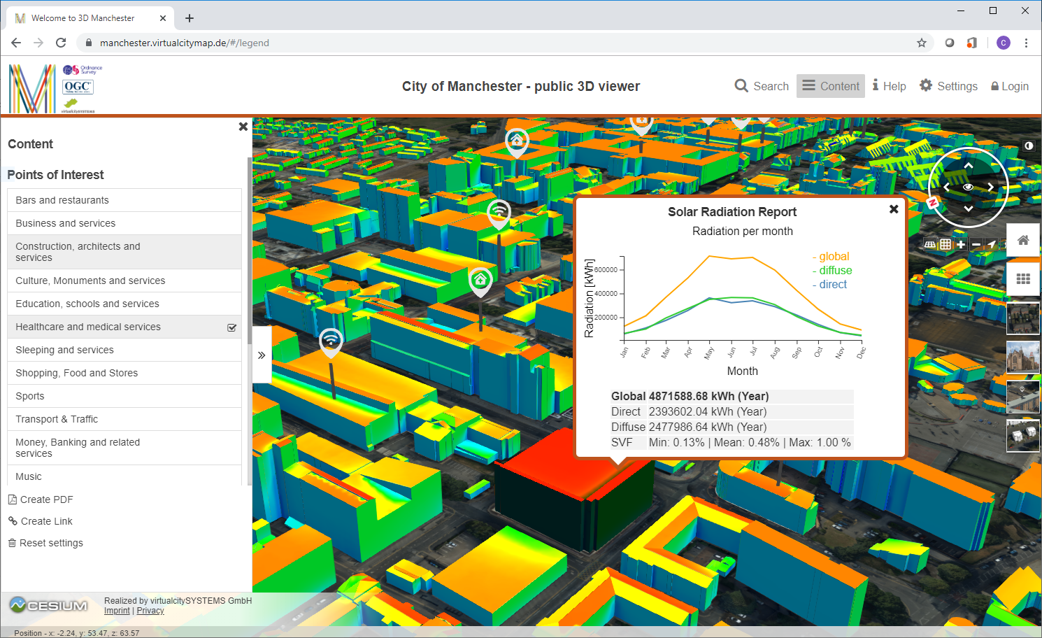
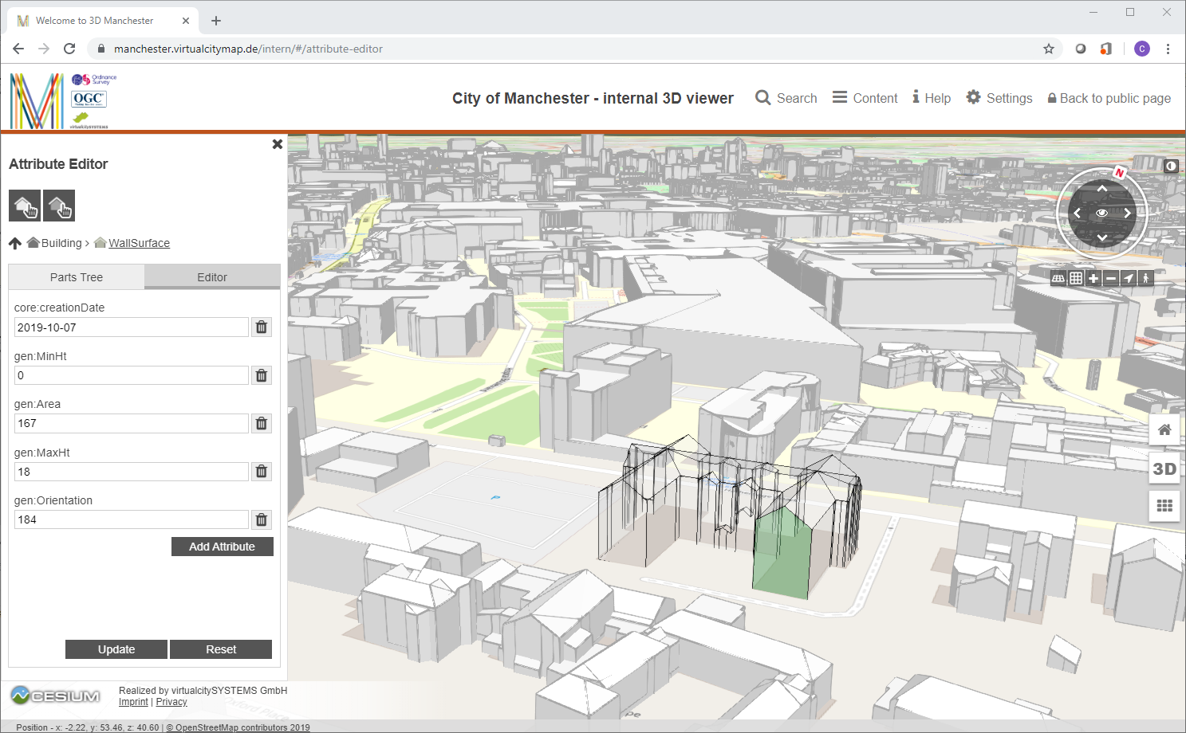
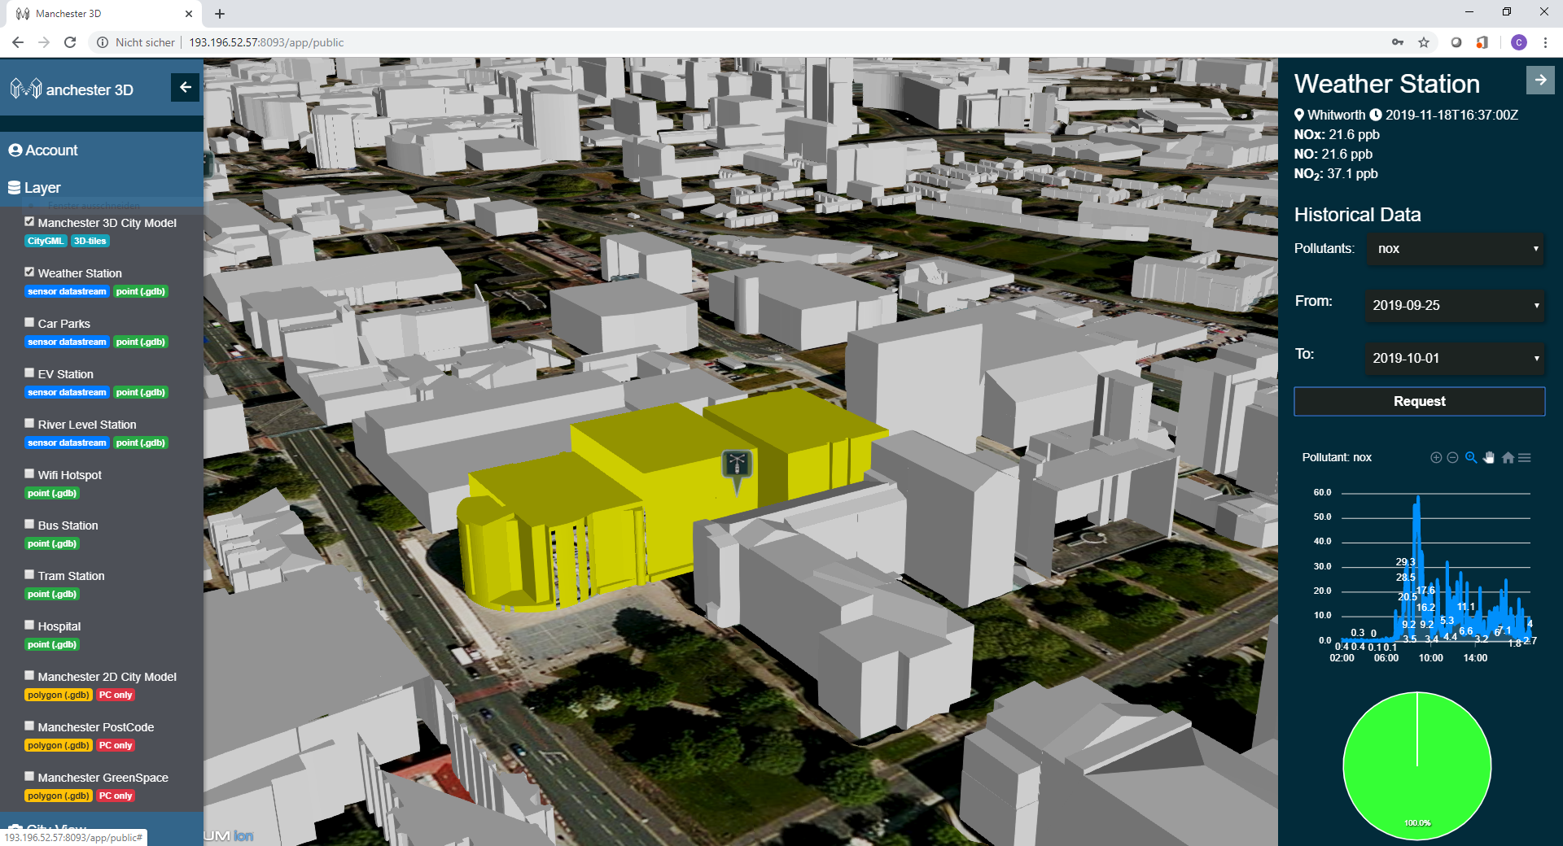
Examples: OGC CityGML 3.0 Challenge

Slide 14
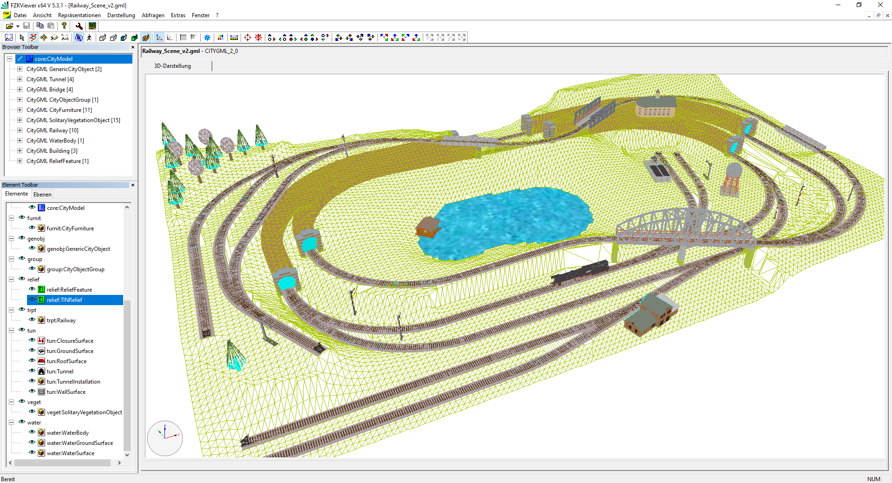
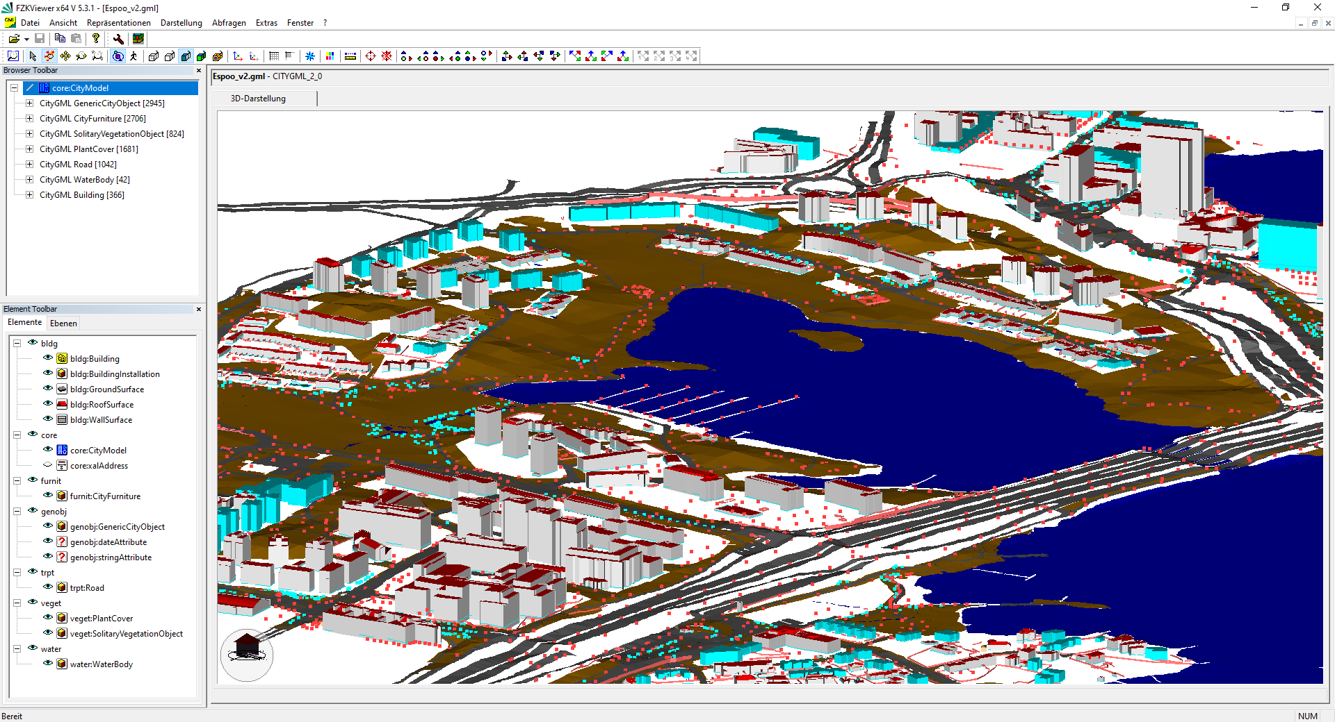
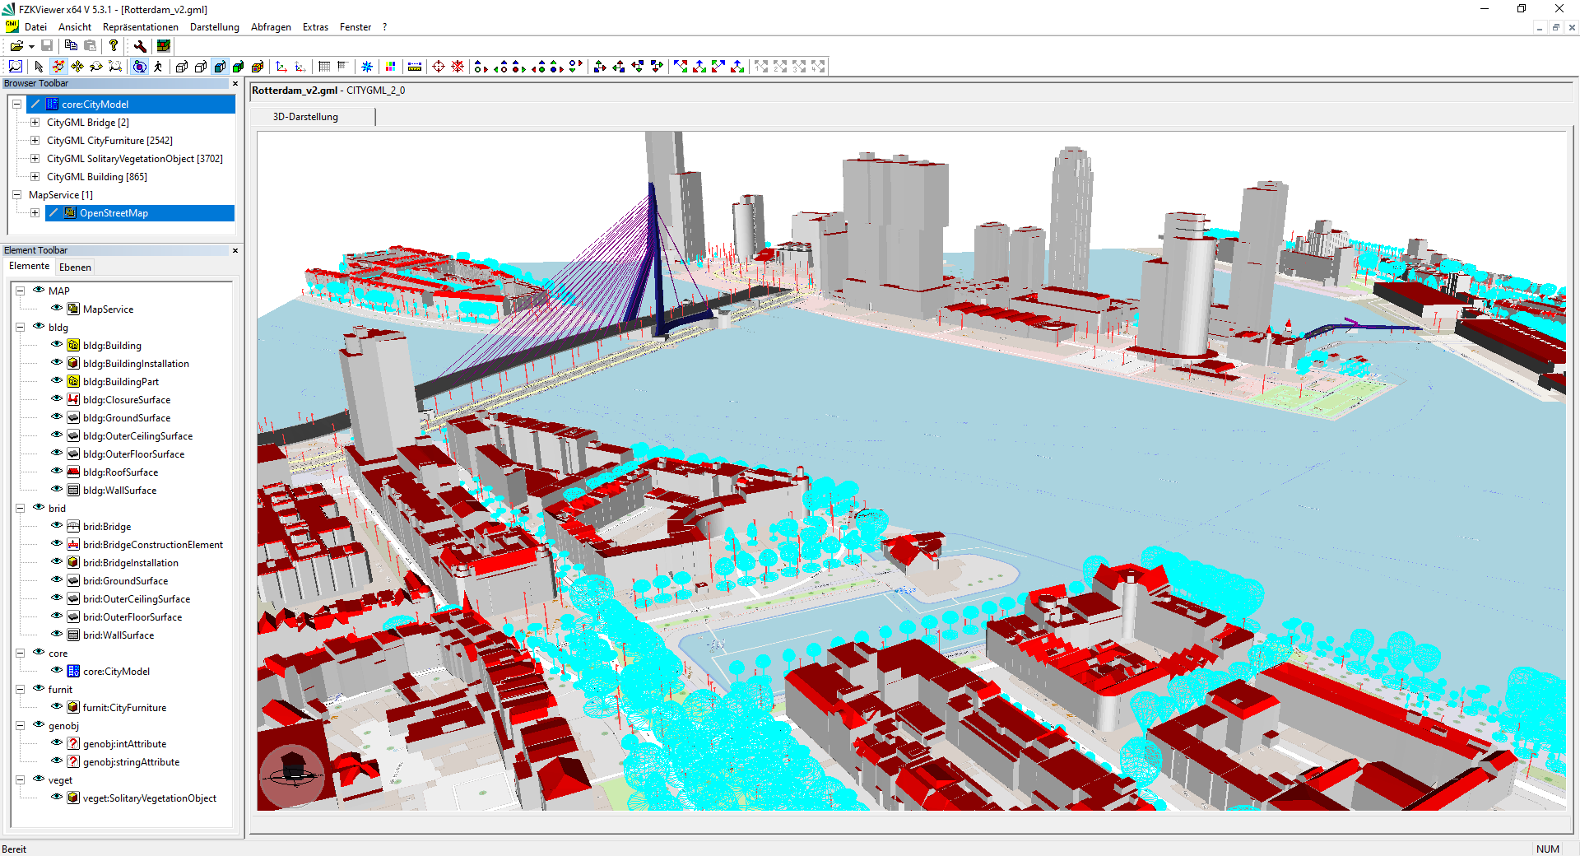
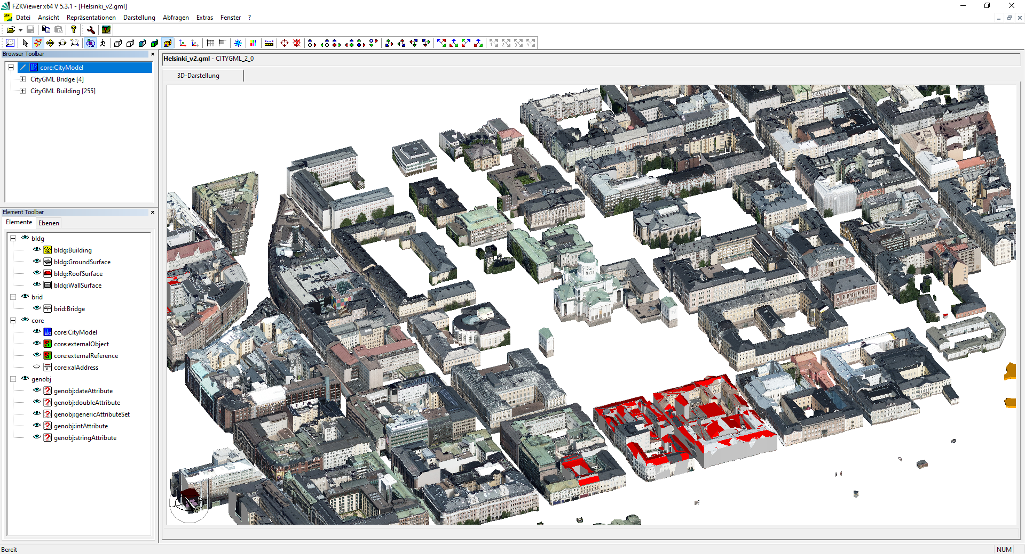
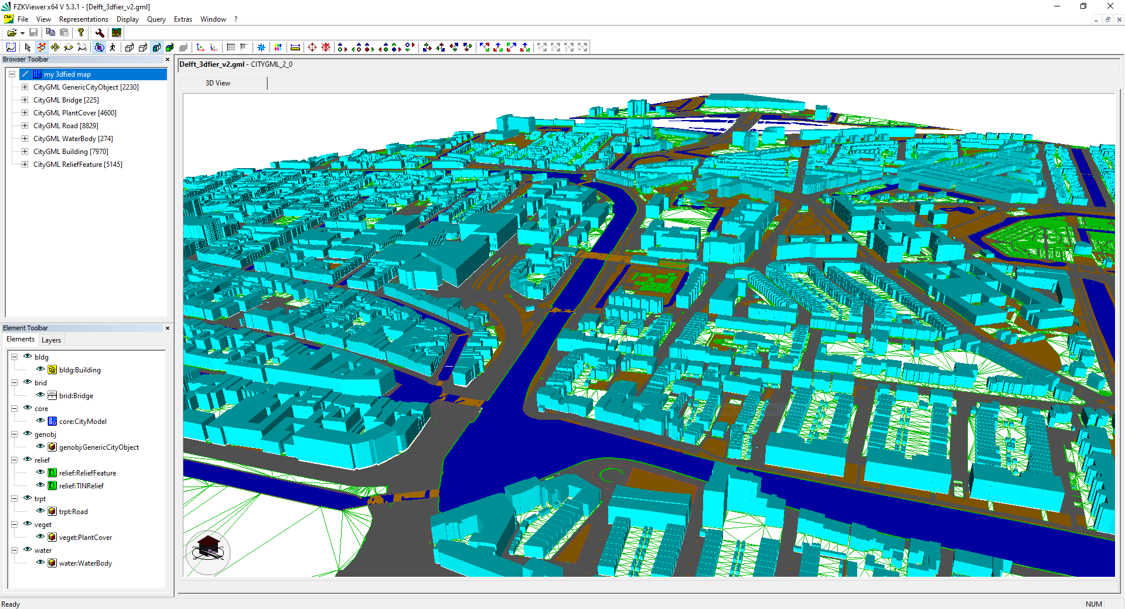
Examples: CityGML 3.0 Test GML Datasets

Slide 15
What has changed between v2 and v3
[Separated conceptual model and encodings]
[This encoding implements the conceptual model 3.0]
[Automated generation of XSD from UML conceptual model.]
[Added additional GML-specific rules]
[ADE GML encodings can be automated.]

Slide 16
Q&A
OAB

Slide 17
CityGML SWG
citygml.swg@lists.opengeospatial.org
Contact info@ogc.org to schedule a meeting for an in-depth discussion with OGC staff and join our community today!
Notes:
If you have any questions, do not hesitate to reach out to OGC or schedule a follow-up. We’re working constantly to change the landscape of location information and want to help your organization get where it needs to go.

Slide 18
Backup Slides Follow

Slide 19
Standardisation Flow
GML Implementations
CityGML 3.0
Implementation specifications
CityGML 3.0
Implementation specification
CityGML 3.0
Conceptual Model
target
target
Encoding technology may restrict extension mechanism
target
CityGML 3.0
ADEs
[may be outside the scope of OGC’s governance]
CityGML 3.0
ADE Encodings
target
target

Slide 20
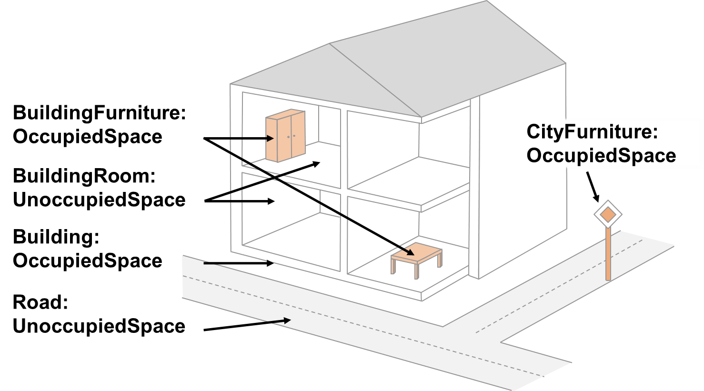
Space
Supports the analysis of navigable spaces (e.g. to generate IndoorGML data from CityGML)
Supports the expression of explicit topological, geometrical, and thematic relations between spaces and spaces, spaces and space boundaries, and space boundaries and space boundaries

Slide 21
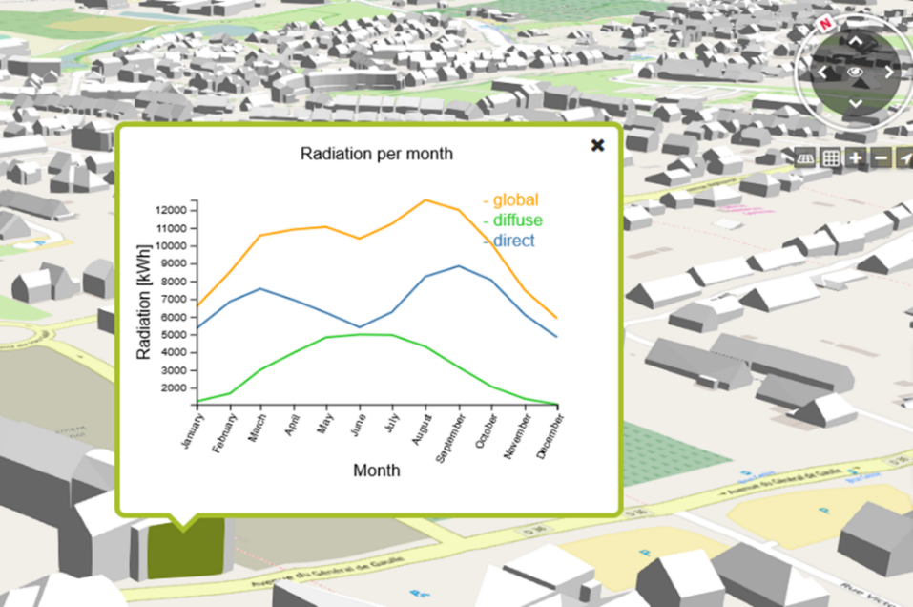
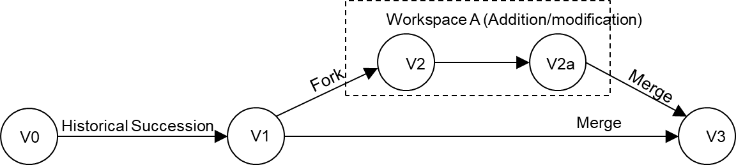
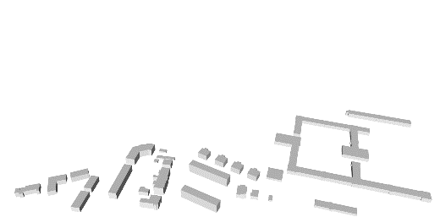
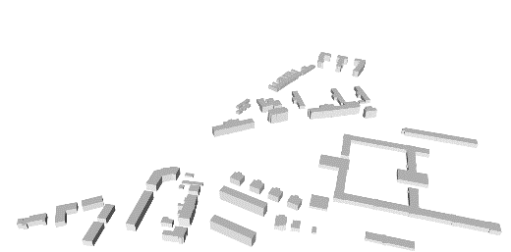
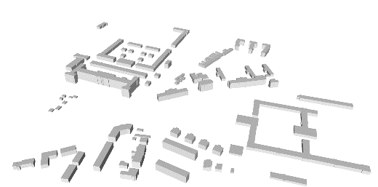
Time
Versioning module
Representation of slow changes (e.g. evolution of cities/city models)
Support of version management (provides the same concepts such as git, workspace managers, SVN)
Dynamizer module
Representation of highly dynamic changes (e.g. real-time data from sensors and results from simulations)
Static attributes of thematic features are overridden with timeseries data

